Slide 1


ENGINEERING MATHEMATICS –III
MINI PROJECT =
Second year { semester – 3}
COMPUTER ENGINEERING
KONKAN GYANPEETH COLLEGE OF ENGINEERING

Slide 2
COLLEGE OF ENGINEERING
[ AFFILIATED TO UNIVERSITY OF MUMBAI,APPROVED BY AICTE ,NEW DELHI
VENGAON ROAD,DAHIVALI,KARJAT-410201,DIST.RAIGAD ]
CERTIFICATE
This is to certify that group no 7 , Miss Shreya mohite -33,
Miss Tejal Mahajan-29,
Miss Tejaswini kachare -26
Of semester III has performed the Mini Project under the guidance of Prof S. H. More Sir in the college premises during the academic year 2022-2023 in the department of “COMPUTER ENGINEERING” subject Engineering Mathematics {III }
Prof S. H. More Sir , Prof S.M. Patil Sir ,
LECTURE INCHARGE HEAD OF DEPARTMENT
Dr. Vilas. J. Pillewan ,
PRINCIPAL

Slide 3
EM-III PROJECT ON FITTING OF EXPONENTIAL CURVE :
PRESENTATION BY :
NAMES : ROLL.NO :
SHREYA VIJAYKUMAR MOHITE - 33
TEJAL SUNIL MAHAJAN - 29
TEJASWINI PANDURANG KACHARE - 26
GUIDED BY :- PROF .S.H.MORE

Slide 4
name of the topic ⇝
fitting of exponential curve !!

Slide 5
CONTENTS :-
DEFINITION
INTRODUCTION
METHOD OF LEAST SQUARES
FITTING OF EXPONENTIAL CURVES
EXAMPLES
APPLICATIONS
CONCLUSION
REFERENCE

Slide 6
DEFINITION:
Curve Fitting is the process of constructing a curve , or mathematical function , that has the best fit to a series of data points , possibly subject to constraints .
It is a statistical technique use to drive coefficient values for equations that express the value of one { dependent } variable as a function of another { independent variable } .

Slide 7
INTRODUCTION:
WHAT IS FITTING OF EXPONENTIAL CURVE ?
The data fit in an exponential function.
The data points appear to fit the curve close to Perfectly, so the relationship can be described as very strong .
As time increases ,the number of customers increases ,so the relationship can be described as positive .

Slide 8
Method of least squares ↪
The method of least squares helps us to find the values of unknowns a and b in such a way that the following two conditions are satisfied:
The sum of the residual (deviations) of observed values of Y and corresponding expected (estimated) values of Y will be zero. ∑(Y–Yˆ)=0.
The sum of the squares of the residual (deviations) of observed values of Y and corresponding expected values (Yˆ) should be at least ∑(Y–Yˆ)2.

Slide 9
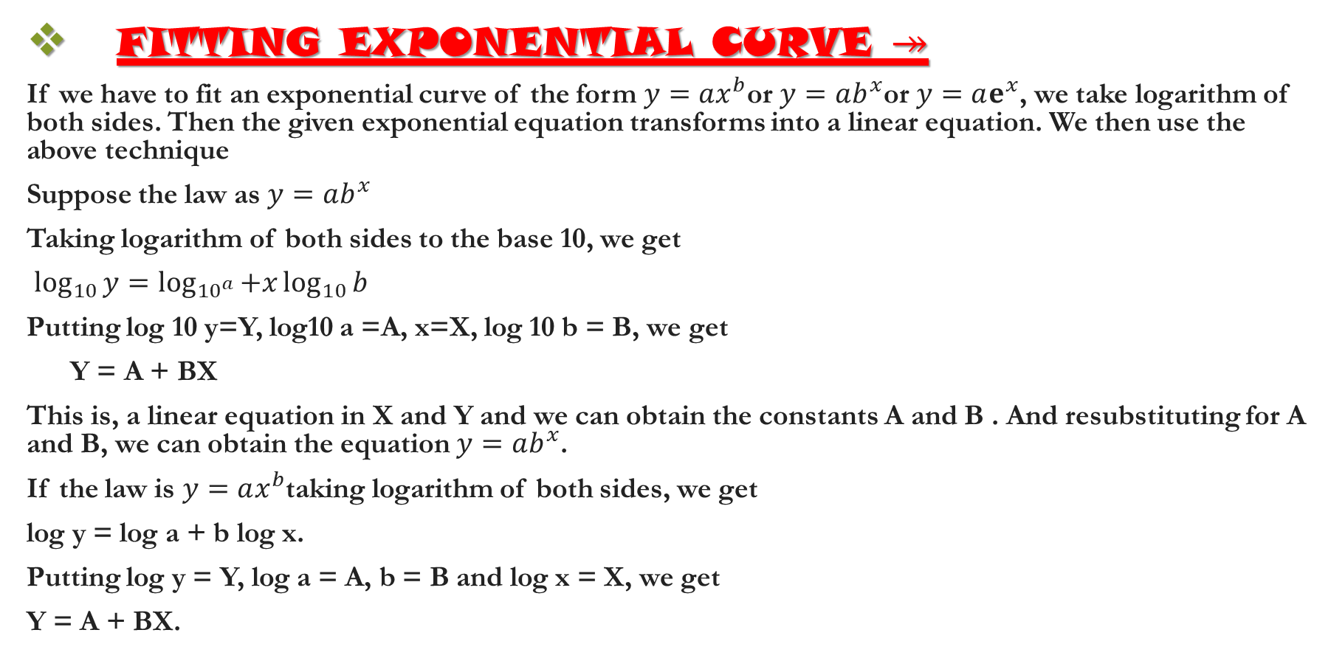
FITTING EXPONENTIAL CURVE ↠
If we have to fit an exponential curve of the form $y=ax^{b}$or $y=ab^{x}$or $y=aⅇ^{x}$, we take logarithm of both sides. Then the given exponential equation transforms into a linear equation. We then use the above technique
Suppose the law as $y=ab^{x}$
Taking logarithm of both sides to the base 10, we get
$\log_{10}{y}=\log_{{10}^{a}}{+x}\log_{10}{b}$
Putting log 10 y=Y, log10 a =A, x=X, log 10 b = B, we get
Y = A + BX
This is, a linear equation in X and Y and we can obtain the constants A and B . And resubstituting for A and B, we can obtain the equation $y=ab^{x}$.
If the law is $y=ax^{b}$taking logarithm of both sides, we get
log y = log a + b log x.
Putting log y = Y, log a = A, b = B and log x = X, we get
Y = A + BX.

Slide 10
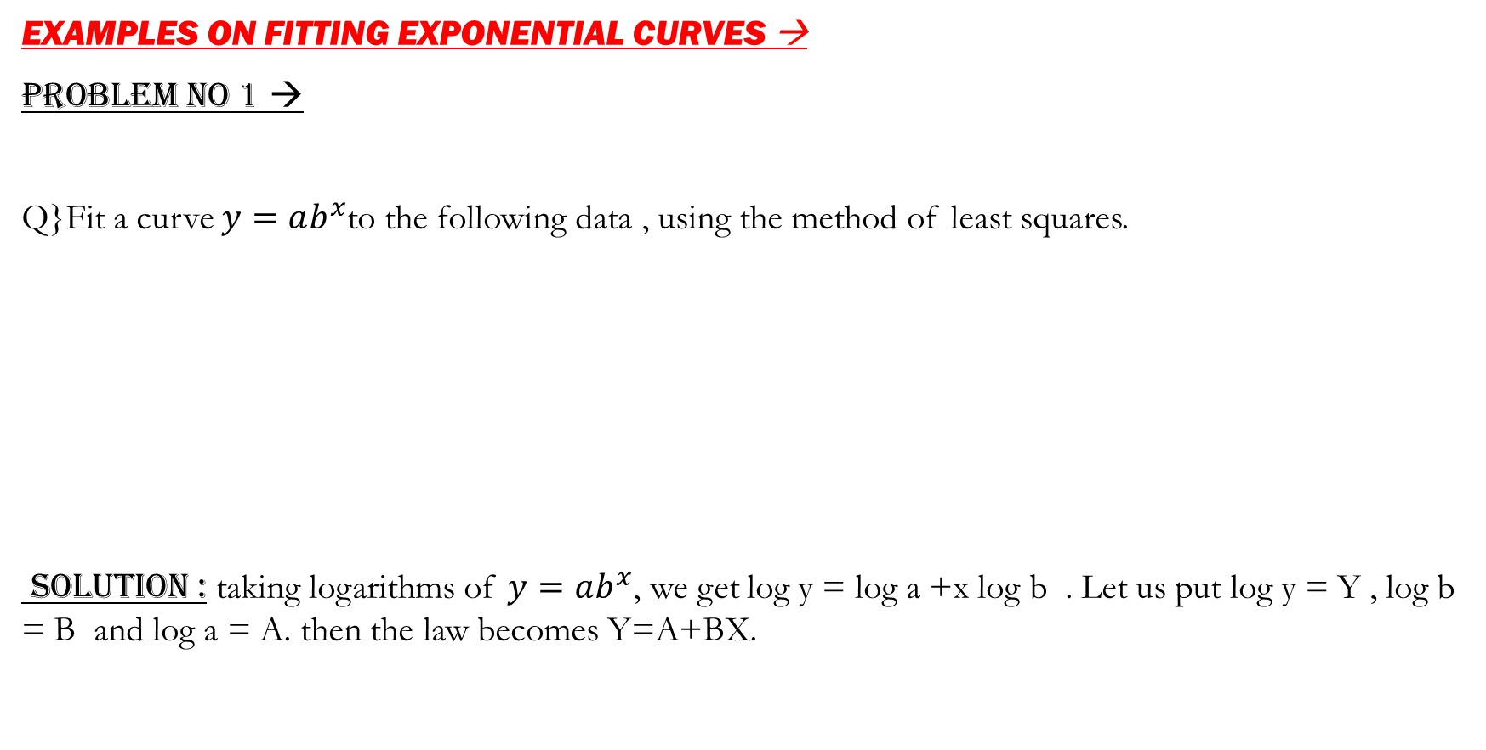
EXAMPLES ON FITTING EXPONENTIAL CURVES →
PROBLEM NO 1 →
Q}Fit a curve $y=ab^{x}$to the following data , using the method of least squares.
SOLUTION : taking logarithms of $y=ab^{x}$, we get log y = log a +x log b . Let us put log y = Y , log b = B and log a = A. then the law becomes Y=A+BX.
X | 0 | 2 | 4
Y | 8.12 | 10 | 31.82

Slide 11
CALCULATING ∑X , ∑Y :
x | y | Y=log y | x Y | x^2
0 | 8.12 | 0.9095 | 0 | 0
2 | 10 | 1 | 2 | 4
4 | 31.82 | 1.5027 | 6.0108 | 16
Σx = 6 |  | ΣY = 3.4122 | Σx Y = 8.0108 | Σx^2 = 20

Slide 12
Now , we have
ΣY = NA+ B ΣX
=> 3.4122 = 3A+ 6B
ΣXY = A ΣX + B ΣX^2
=> 8.0180=6A+20B
Solving the above two equations , we get
A = 0.8408 & B = 0.1483
Hence ,
a = antilog [ 0.8408 ] , b=antilog [0.1483]
∴ a = 6.9310 , b= 1.4070
put the values of a and b in the given equation we get,
y=6.9310[1.4070]^x

Slide 13

PROBLEM NO 2 →
Q } Fit a curve of the form $y=ab^{x}$ to the following data .
SOLUTION → let the equation of the curve be $y=ab^{x}$.
taking logarithm of both sides , we get
log y = log a + x log b
Let log y = Y , log a = A , log b = B , x = X
X | 1 | 2 | 3 | 4 | 5 | 6
y | 151 | 100 | 61 | 50 | 20 | 8

Slide 14
∴ Y = A + B X
calculations of ∑X , ∑ Y , etc .
Sr . No | X = x | Y | Y = log y | X^2 | XY
1 | 1 | 151 | 2.1790 | 1 | 2.1790
2 | 2 | 100 | 2.0000 | 4 | 4.0000
3 | 3 | 61 | 1.7853 | 9 | 5.3559
4 | 4 | 50 | 1.6990 | 16 | 6.7960
5 | 5 | 20 | 1.3010 | 25 | 6.5050
6 | 6 | 8 | 0.9031 | 36 | 5.4186
N = 6 | 21 |  | 9.8674 | 91 | 30.2545

Slide 15

Now , the normal equations are
$Σy=NA+B\sum{X}$
$Σxy=AΣx+B\sum{x^{2}}$
Putting the above values , we get ,
$9⋅8674=6A+21B$ …………..[1]
$30.2545=21A+91B$ …………..[2]
Multiply [1] by 7 and [2] by 2 and subtract .
∴ $\begin{matrix}69.0718=42A+147B \\ 60.5090=42A+182B\end{matrix}$
8.5628 = - 35 B
∴ B = -0.2447
Putting the value of B in [1] , we get

Slide 16
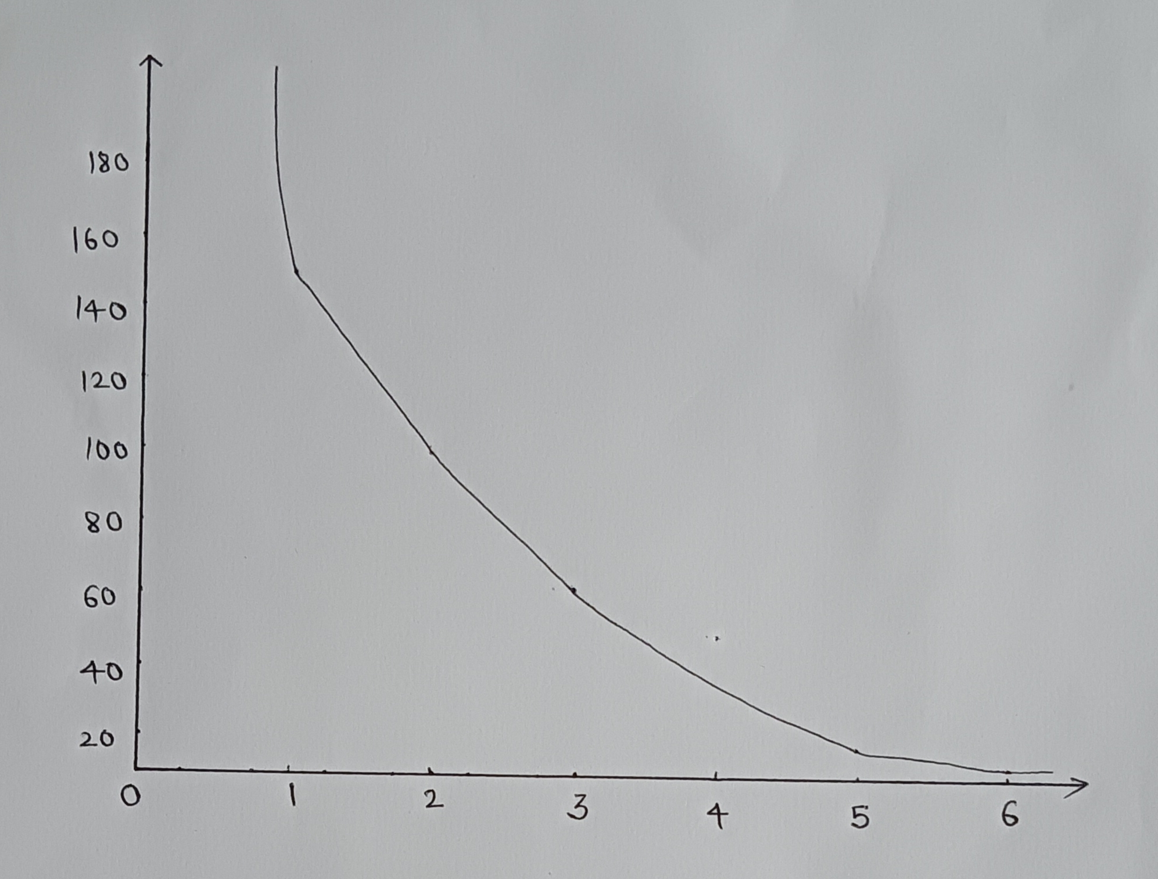
9.8674 = 6A + 21 ( -0.2447)
∴ 6 A = 9.8674 + 5.1387
6A = 15.0061
A = 2.5010
∴ a = antilog A = 316.96
b = antilog B = 0.5692
∴ put the values of a and b in the given equation we get,
∴ y = 316.96 ( 0.5692)^x .

Slide 17
APPLICATIONS : - >
Curve fitting examines the relationship between one or more predictors { independent variables } and a response variables { dependent variables } , with the goal of dealing a “ best fit “ model of the relationship
Many processes in nature have exponential dependencies. The decay with time of the amplitude of a pendulum swinging in air, the decrease in time of the temperature of an object that is initially warmer than its surroundings, and the growth in time of an initially small bacterial colony are all processes that are well-modeled by exponential relationships. To better consider the issues involved in dealing with such relationships, let's consider a very specific case. The absorption of radiation by a given thickness of some material can be modeled by the following simple exponential relationship:
R(x) = Roe Bx

Slide 18
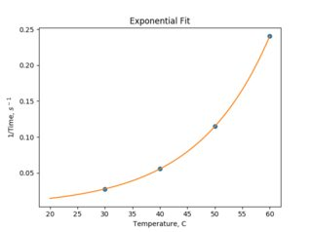
Here R(x) is the count rate of radiation particles (typically measured as the number of clicks on a Geiger counter that take place in some fixed time such as one minute), R, is the count rate with no shielding present, x is the thickness of the shielding material, and ẞ is a negative constant that de scribes how rapidly the count rate decreases as the shielding thickness increases.
.

Slide 19
CONCLUSION →
So here we have come to an end of the engineering mathematics III mini project which was based on fitting of exponential curve .
We have tried are level best to include all the necessary points which were important related and required
about the given topic.

Slide 20
REFERENCES ➔
1 : Engineering mathematics III by G.V . Kumbhojkar .
2 : probability , statistics and random processes, T. Veerarajan , Mc Graw – Hill Education .
3 : Higher Education Mathematics , Dr . B.S. Grewal , Khanna Publications.

Slide 21



